Slide 1
Inventory System using Spring Boot
CREATED BY :-
Pratap Sakat :- EONFWL618567
Sahithi Tantravedi :- EBEON0622615707
Mayuri Kalbhor :- EBEON0622617904
Guided by
Varadharajan sir.

Slide 2
INDEX
SR NO | TITLE
1) | INTRODUCTION
2) | MODULE LIST
3) | MODULE DETAILS
4) | TECHNOLOGU USED
5) | SYSTEM CONFIGURATION
6) | CONTROL FLOW DIAGRAM
7) | FUTURE ENHANCEMENT
8) | CONCLUSION
9) | THAK YOU….

Slide 3
Introduction
The Ice cream shop pos system is developed using Spring boot. The project is built to manage sales and transactions. To make a new transaction, fields such as: Ice cream type and Drink type, qty needs to be selected. If you like to learn point of sales systems step by step, this is the right place to learn from the beginning. In this tutorial useful for making a point of sales system for a small shops.

Slide 4
Ice Cream Inventory System using Spring Boot Module List :-
Items
Products
Automatic Billing System

Slide 5
Ice Cream Inventory System using Spring Boot
Can add Ice Cream
Can add Quantity
Automatic Billing System
Reset add item

Slide 6
Technology Used
Backend :Spring Boot, Spring MVC, Java , Servlet
Frontend :JSP , HTML , CSS , Java Script
Styling : Bootstrap
Project Management : Maven
Database :MYSQL
Server : Embedded Tomcat Server

Slide 7
System Configuration
The user should have the appropriate version of windows.
The system should have up to 1 GB ram minimum requirement for the application.
The application should be installed on the system.
Internet Connectivity is a must for this purpose.
CPU with a speed of 1.3Ghz is a good choice for normal usage.

Slide 8
Control Flow Diagram
Product
Management
Ice Cream Inventory System using Spring Boot
Billing
Quantity
Sales Management

Slide 9
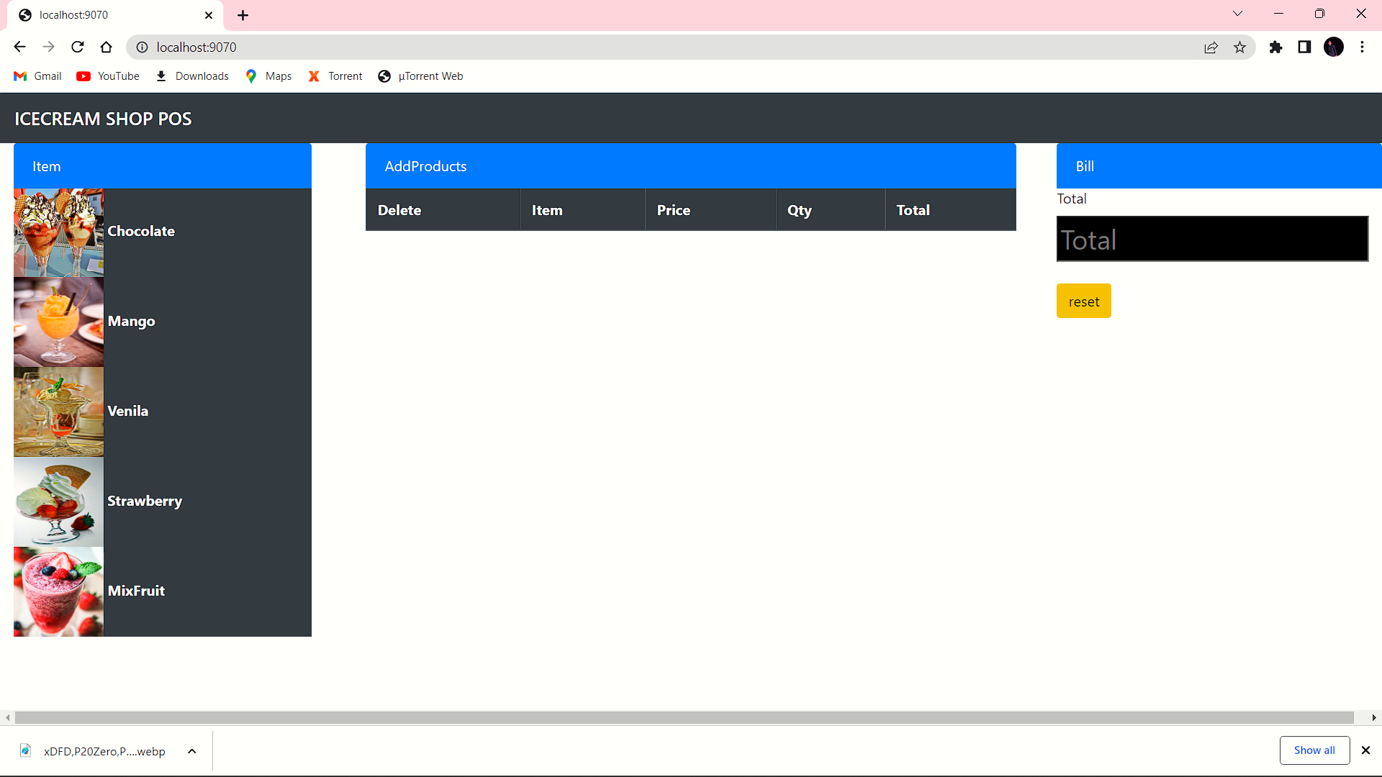

Slide 10
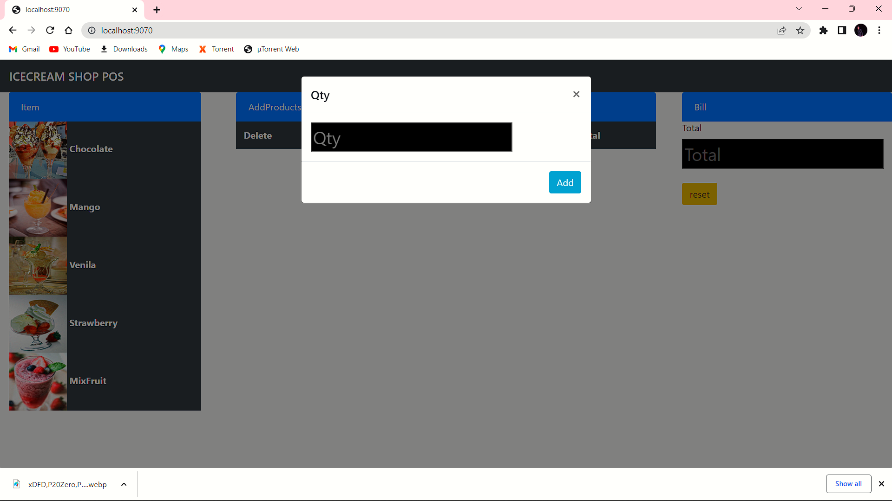

Slide 11


Slide 12
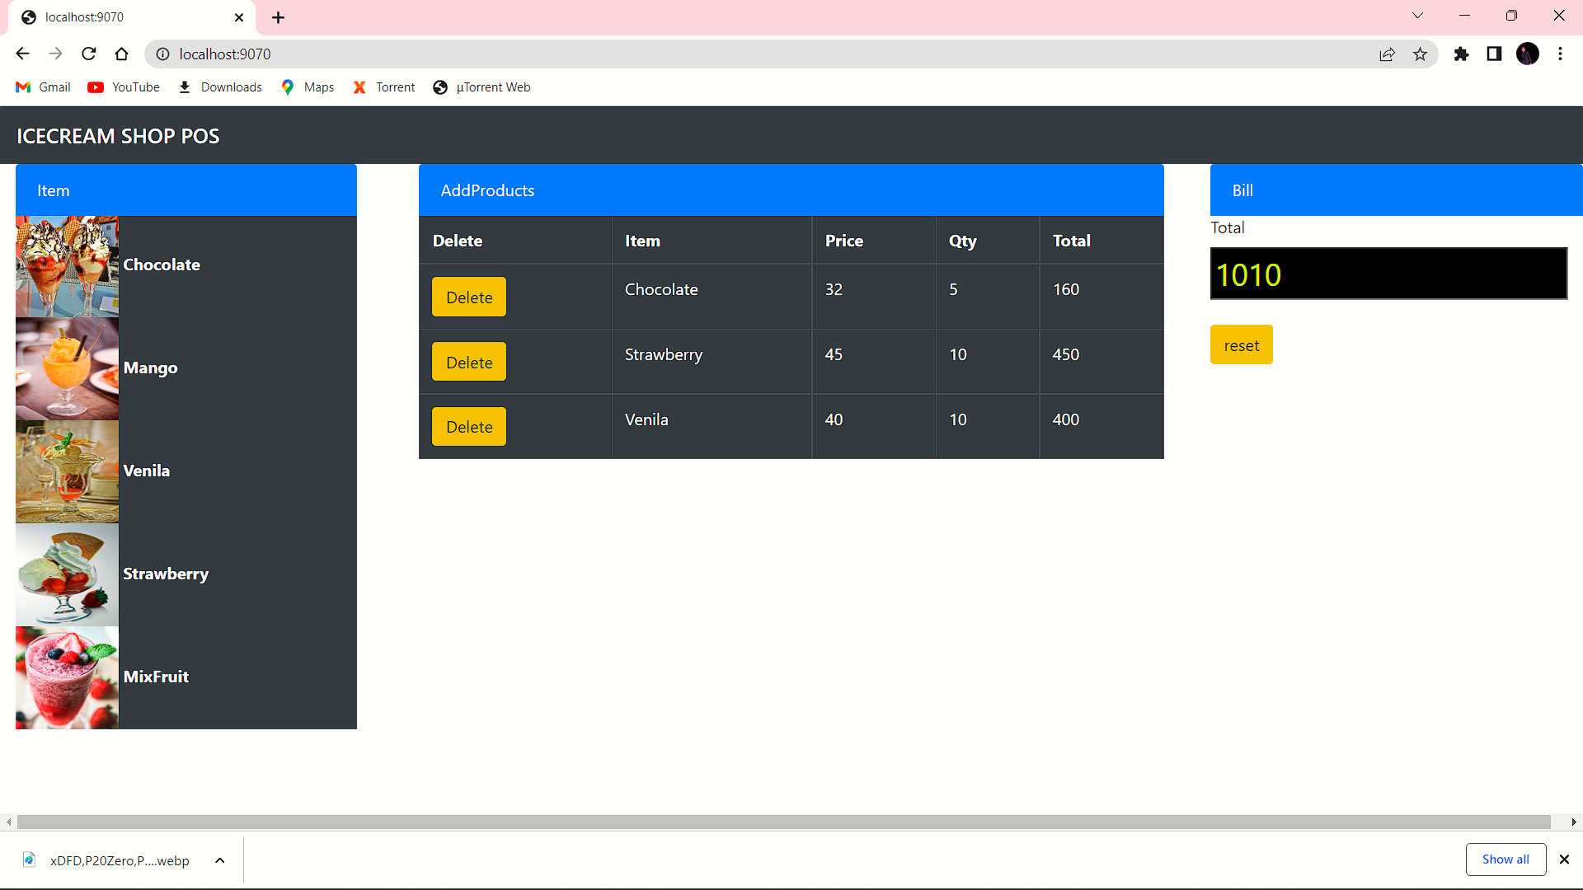

Slide 13
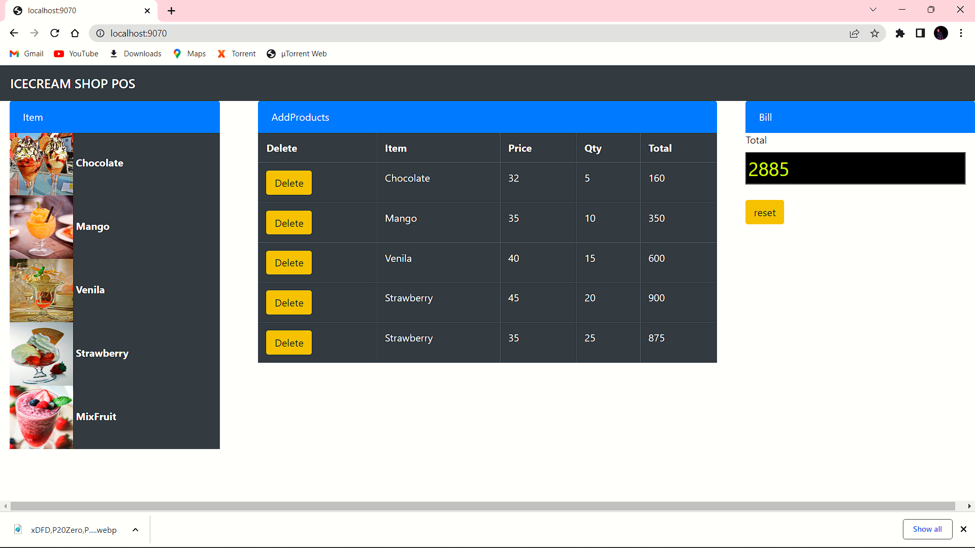

Slide 14
Future Enhancement
Ice cream is temperamental. One negligent moment of leaving a fridge open can spoil a lot of stock, leading to a double down of losses, goods and reputational damage. Yet with display fridges spread across the globe in fuel stations, supermarkets and cafes, it is impossible to control the ecosystem sufficiently. Compounding this are the traditional fridges, which, though apt at cooling, are not sophisticated enough to lend a hand. Worse still, replacing them all with modern equivalents presents a huge and often debilitating cost.

Slide 15
Conclusion
This software reduces the amount of manual data entry and gives greater efficiency. The User Interface of it is very friendly and can be easily used by anyone.

Slide 16
THANK YOU……..

